Slide 1
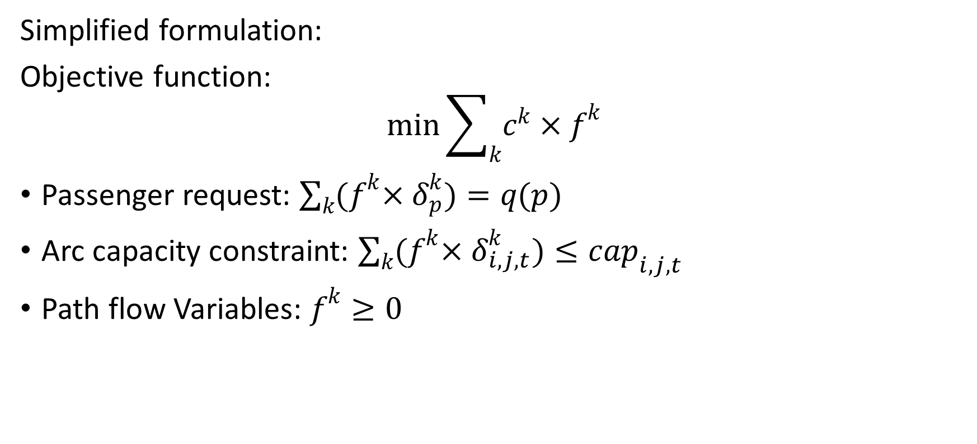
1. Model: traffic assignment with passenger pickup and drop-off requests and road capacity
Simplified formulation:
Objective function:
$$\min{\sum_{k}{c^{k}×f^{k}}}$$
Passenger request: $\sum_{k}{{(f}^{k}×δ_{p}^{k}})=q(p)$
Arc capacity constraint: $\sum_{k}{{(f}^{k}×δ_{i,j,t}^{k}})≤cap_{i,j,t}$
Path flow Variables: $f^{k}≥0$

Slide 2
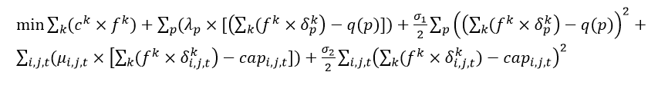
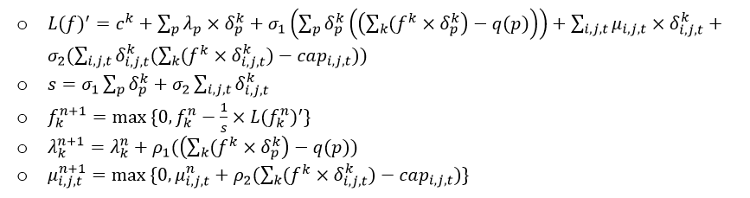
2. Flow-based ADMM
Objective function:
Newton method

